Slide 1
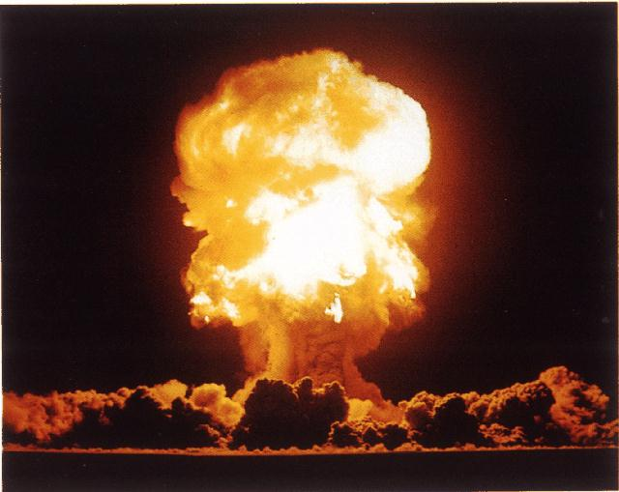
ATOMIC STRUCTURE
S.MORRIS 2006

Slide 2
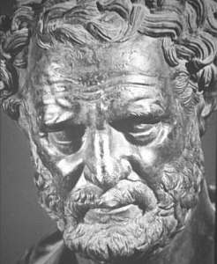
HISTORY OF THE ATOM
460 BC
Democritus develops the idea of atoms
he pounded up materials in his pestle and mortar until he had reduced them to smaller and smaller particles which he called
ATOMA
(greek for indivisible)

Slide 3
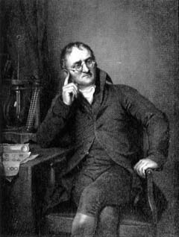
HISTORY OF THE ATOM
1808
John Dalton
suggested that all matter was made up of tiny spheres that were able to bounce around with perfect elasticity and called them
ATOMS

Slide 4
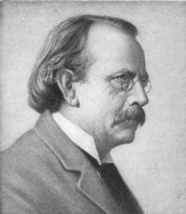
HISTORY OF THE ATOM
1898
Joseph John Thompson
found that atoms could sometimes eject a far smaller negative particle which he called an
ELECTRON

Slide 5
HISTORY OF THE ATOM
1904
Thompson develops the idea that an atom was made up of electrons scattered unevenly within an elastic sphere surrounded by a soup of positive charge to balance the electron's charge
like plums surrounded by pudding.
PLUM PUDDING
MODEL

Slide 6
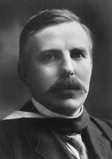
HISTORY OF THE ATOM
1910
Ernest Rutherford
oversaw Geiger and Marsden carrying out his famous experiment.
they fired Helium nuclei at a piece of gold foil which was only a few atoms thick.
they found that although most of them passed through. About 1 in 10,000 hit

Slide 7
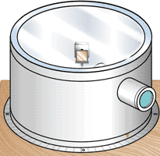
HISTORY OF THE ATOM
gold foil
helium nuclei
helium nuclei
They found that while most of the helium nuclei passed through the foil, a small number were deflected and, to their surprise, some helium nuclei bounced straight back.

Slide 8
HISTORY OF THE ATOM
Rutherford’s new evidence allowed him to propose a more detailed model with a central nucleus.
He suggested that the positive charge was all in a central nucleus. With this holding the electrons in place by electrical attraction
However, this was not the end of the story.

Slide 9
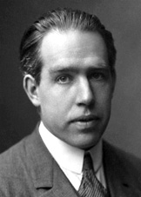
HISTORY OF THE ATOM
1913
Niels Bohr
studied under Rutherford at the Victoria University in Manchester.
Bohr refined Rutherford's idea by adding that the electrons were in orbits. Rather like planets orbiting the sun. With each orbit only able to contain a set number of electrons.

Slide 10
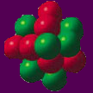
Bohr’s Atom
electrons in orbits
nucleus

Slide 11
HELIUM ATOM
Shell
proton
N
+
-
+
-
N
neutron
electron
What do these particles consist of?

Slide 12
ATOMIC STRUCTURE
Particle
Charge
Mass
proton
+ ve charge
1
neutron
No charge
1
electron
-ve charge
nil

Slide 13
ATOMIC STRUCTURE
He
2
Atomic number
the number of protons in an atom
4
Atomic mass
the number of protons and
neutrons in an atom
number of electrons = number of protons

Slide 14
ATOMIC STRUCTURE
Electrons are arranged in Energy Levels or Shells around the nucleus of an atom.
first shell a maximum of 2 electrons
second shell a maximum of 8 electrons
third shell a maximum of 8 electrons

Slide 15
ATOMIC STRUCTURE
There are two ways to represent the atomic structure of an element or compound;
1. Electronic Configuration
2. Dot & Cross Diagrams

Slide 16
ELECTRONIC CONFIGURATION
With electronic configuration elements are represented numerically by the number of electrons in their shells and number of shells. For example;
Nitrogen
configuration = 2 , 5
2 in 1st shell
5 in 2nd shell
7
N
2 + 5 = 7
14

Slide 17
ELECTRONIC CONFIGURATION
Write the electronic configuration for the following elements;
20
11
8
Ca
Na
O
a)
b)
c)
23
16
40
2,8,8,2
2,8,1
2,6
17
14
5
d)
Cl
e)
Si
f)
B
35
28
11
2,8,7
2,8,4
2,3

Slide 18
DOT & CROSS DIAGRAMS
With Dot & Cross diagrams elements and compounds are represented by Dots or Crosses to show electrons, and circles to show the shells. For example;
X
Nitrogen
N
7
X
X
N
X
X
14
X
X

Slide 19
DOT & CROSS DIAGRAMS
Draw the Dot & Cross diagrams for the following elements;
X
8
17
O
Cl
X
a)
b)
X
16
35
X
X
X
X
X
X
X
Cl
X
X
X
X
X
X
O
X
X
X
X
X
X
X
X
X
X

Slide 20
SUMMARY
The Atomic Number of an atom = number of
protons in the nucleus.
The Atomic Mass of an atom = number of
Protons + Neutrons in the nucleus.
The number of Protons = Number of Electrons.
Electrons orbit the nucleus in shells.
Each shell can only carry a set number of electrons.

Slide 21
This powerpoint was kindly donated to www.worldofteaching.com
https://www.worldofteaching.com is home to over a thousand powerpoints submitted by teachers. This is a completely free site and requires no registration. Please visit and I hope it will help in your teaching.

